Slide 1


G. Narayanamma Institute of Technology and Science(for women)
Water Quality Monitoring using Image Processing and Neural Networks
A. Sai Sravya 19251A0501 Akhila Mailaram 19251A0538 Basa Pavani Naga Kumari 19251A0551 Banvita Yadam 19d21A05B3
Internal Guide Mrs. Jayashree S Patil Associate Professor

Slide 2
Introduction :
The quality of water seriously affects human health and is one of the important factors for global economic development.
Therefore, the quest for a simple, quick, low cost, and reliable system for monitoring the water quality is of great practical importance
In the aquaculture industry, because water color can reflect the species and number of phytoplankton in the water, the water quality type can be obtained by analyzing the color of the water using image processing techniques and neural networks.

Slide 3
Contents :
Introduction
Existing Systems
Problem Statement
Objectives
Literature survey
Software and Hardware Requirements
Methodology
Architecture
List of Modules

Slide 4
Existing Systems :
Internet of Things based water quality monitoring system - This method is costly and not easy to promote.
A Flying ad-hoc model - This method seriously relies on the sensorial devices and complex circuit control system.
Multiple variables were collected to evaluate and monitor the coastal water quality using principal component analysis for dimensional reduction, while the calculation process is complex and time consuming.

Slide 5
Drawbacks of Existing Systems :
The methods mentioned in existing systems consume manpower, financial resources, and have high cost and large time lag.
The limitations of ANNs are slow convergence speed, long training time, multiple parameters assignment , and so on.
Deep learning (DL) techniques, convolutional neural networks (CNNs) - Collecting a large tagged dataset for model training is undoubtedly a challenging problem.
Thus, transfer learning and network fine tuning will be employed in the practices.

Slide 6
Problem Statement:
“Image processing techniques are used to analyze the color of water to obtain the water quality type . The critical features of water color images are extracted, and then using the Deep learning methods, an intelligent system for water quality monitoring is established based on the Neural Networks and Transfer learning.”

Slide 7
Proposed System:
The deep learning approach for image recognition includes the processes of feature extraction and image classification, in which feature extraction is crucial, and its quality directly determines the final effect of image recognition.
Aiming at diverse sample images, the features of the images are extracted combining with diverse classifiers to solve the image classification problems.

Slide 8
Objectives:
To monitor the water quality using image processing and neural networks
To outline the RGB colour moments of the water image which are to be used for efficient classification of the images in terms of quality.
To achieve higher classification accuracy even in the absence of massive training samples.

Slide 9
Literature Survey :
S no | Title | Techniques | Software | Limitations
1 | Intelligent monitoring method of water quality based on image processing and RVFL-GMDH model (2021) | transfer learning and network fine tuning | Image processing and neural networks | slow convergence speed, long training time, multiple parameters assignment
2 | Image Processing Techniques Applicable to Wastewater Quality Detection (2018) | Electron tomography, Linear Contrast Stretching technique | Image processing | Collecting a large tagged dataset
3 | Classifying Natural Waters with the Forel-Ule Color Index System(2015) | Handheld FUI Scale | Image processing and IOT | costly and not easy to promote
4 | Water Quality Classification for Inland Lakes and Ponds with Few Color Image Samples Based on Triple-GAN and CSNN(2022) | Triple-GAN and convolution spiking neural network (CSNN) | Image processing and deep learning techniques | More computation and time consuming
5 | Random vector functional link network: recent developments(2022) | RVFL Neural networks | Deep learning | Very less work done to handle semi supervised problems.

Slide 10
System Requirements:
Software Requirements:
Platform - VS Code
Development Tool - Jupyter Notebook, Tensorflow, Keras.
Back End - Python
Hardware Requirements:
Name of the Processor - Intel® Core™ i7-8565U
Hard Disk Capacity - 908 GB
RAM Capacity - 8 GB

Slide 11
Methodology:
Suitable water sample images are collected and the representative parts are cut by adopting image incision technology.
Categorized accordingly, and the labelled images are used for modelling.
The crucial features including the colour moments of each colour channel are extracted and chosen to build the model.
Then, the feature samples are given as input to the proposed model.

Slide 12
Architecture:
Start
Taking water images
Cutting the images to equal pixels
Extracting colour moment features
Sample labelling
Labelled data
Training data
Model establishment
Test/Validation data
Detected category results

Slide 13
List of Modules:
Data Acquisition
Data Preprocessing
Features Extraction using colour moments
Model establishment
Results and Evaluation
Creating a UI to provide information about the parameters of water

Slide 14
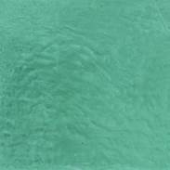
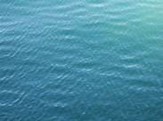
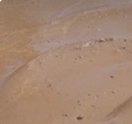
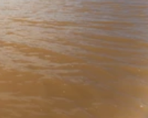
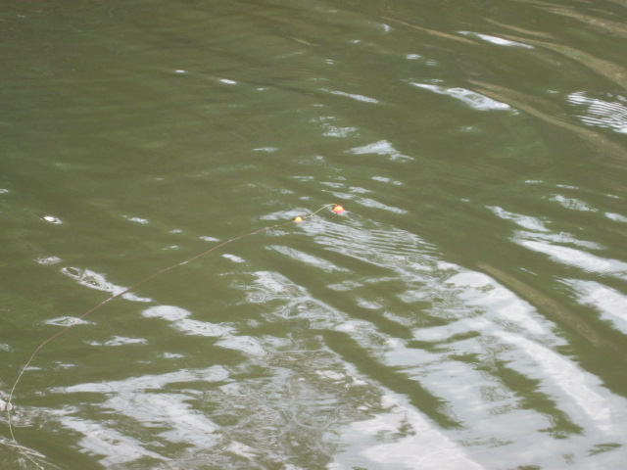
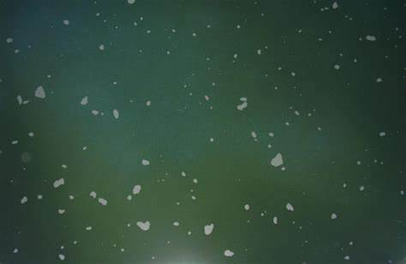
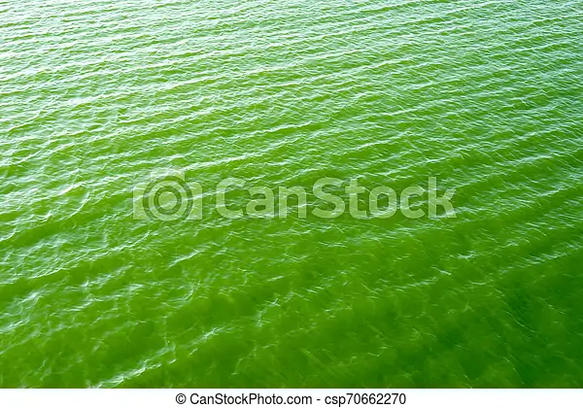
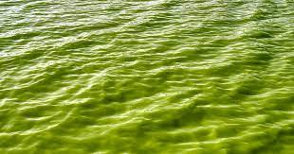
Data acquisition:
Clean water
Mud water
Polluted Water
Water with algae content

Slide 15
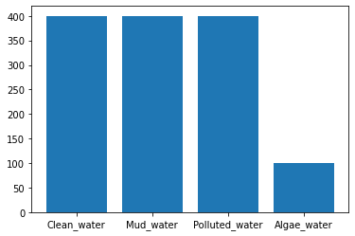
Dataset
Total number of images collected are around 1700
The images are divided into 4 types 500 each:
Polluted water- 0
Clean water - 1
Mud water - 2
Algae water - 3

Slide 16
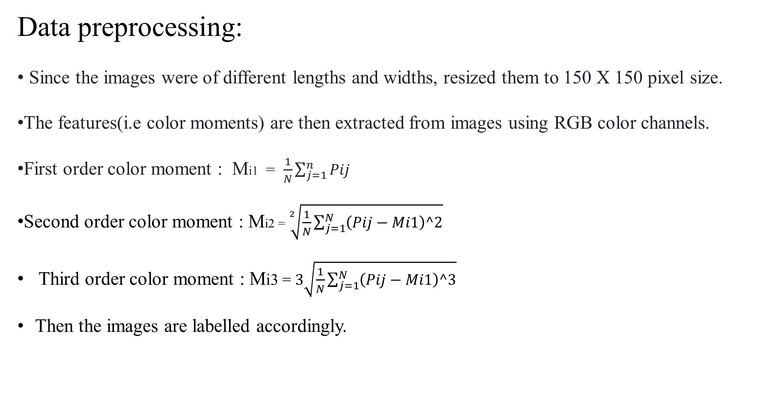
Data preprocessing:
Since the images were of different lengths and widths, resized them to 150 X 150 pixel size.
The features(i.e color moments) are then extracted from images using RGB color channels.
First order color moment : Mi1 = $\frac{1}{N}\sum_{j=1}^{n}{Pij}$
Second order color moment : Mi2 = $\sqrt[2]{\frac{1}{N}\sum_{j=1}^{N}{\left(Pij−Mi1\right)^2}}$
Third order color moment : Mi3 = $3\sqrt{\frac{1}{N}\sum_{j=1}^{N}{\left(Pij−Mi1\right)^3}}$
Then the images are labelled accordingly.

Slide 17
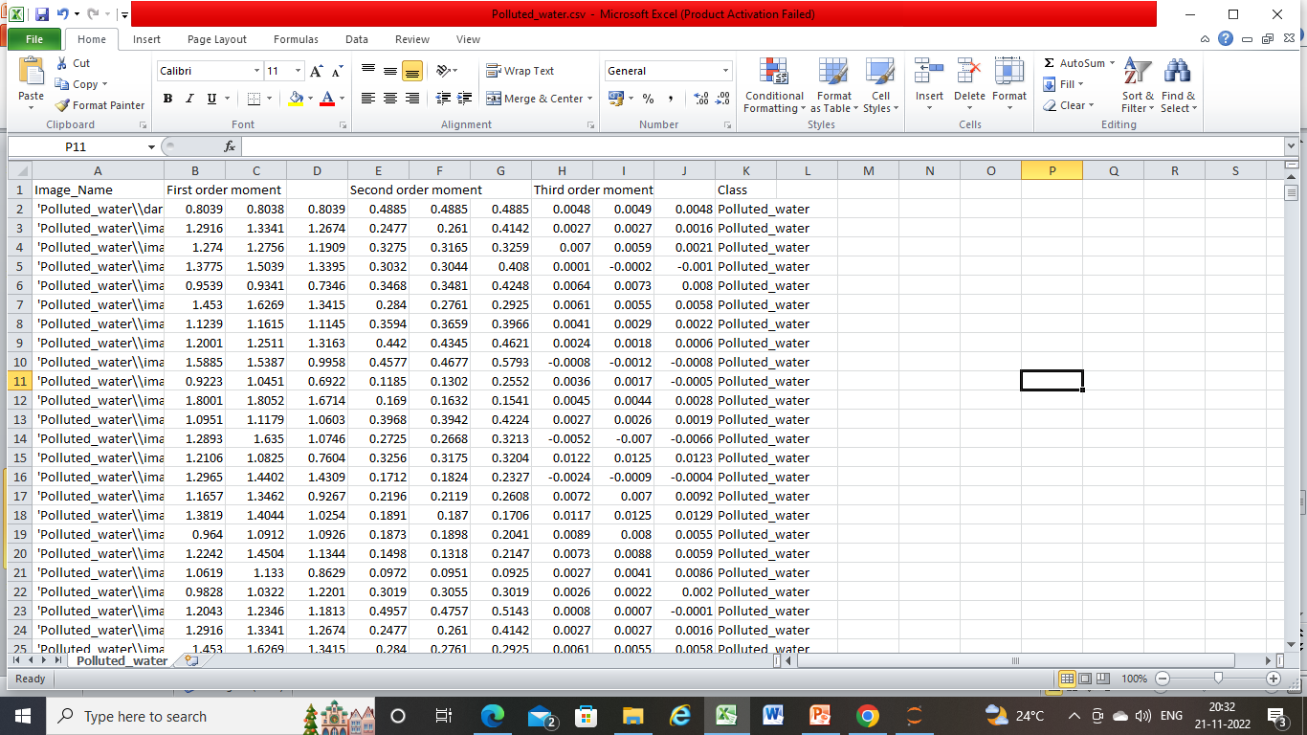
Feature extraction:

Slide 18
Models used:
Machine learning methods:
Decision Tree
Logistic Regression
Random Forest
MLP(Multi layer perceptron)
Deep learning methods:
CNN
VGG16 model

Slide 19
Model establishment using Machine learning algorithms:
The features extracted from the images with the help of color moments are used to train the system using machine learning algorithms.
The measure of accuracy given by machine learning algorithms are as follows:
Decision Trees – 82.2%
Random Forest – 85.5%
Logistic regression – 84.4%
Multi layer Perceptron – 91.7%

Slide 20
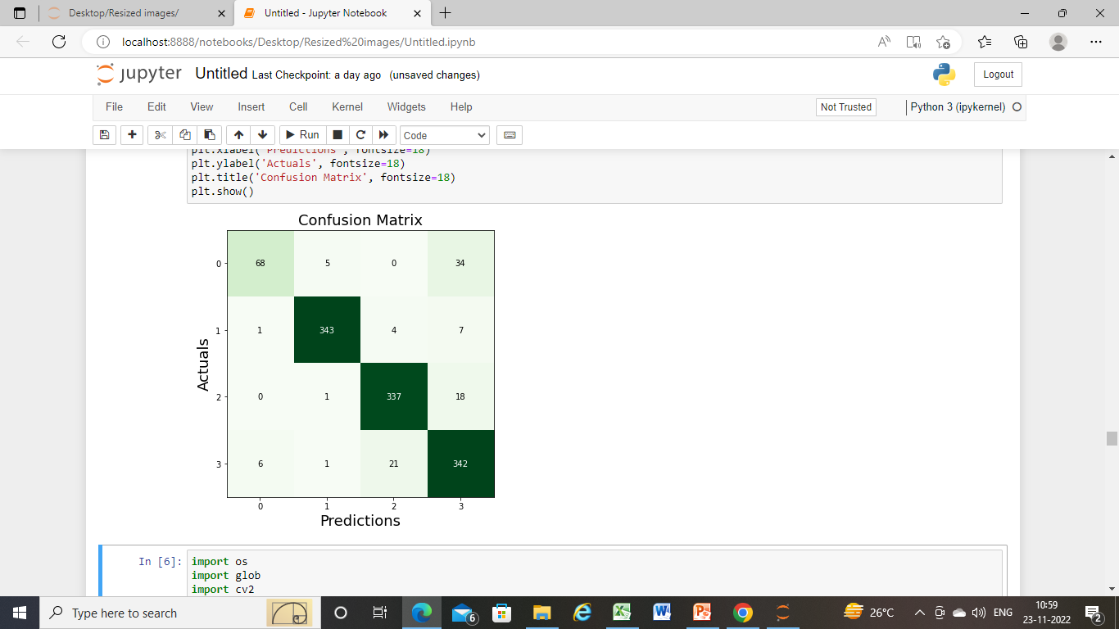
Predictions based on MLP machine learning algorithm:

Slide 21
Model establishment using CNN:
Since the images are of different lengths and widths, resized them to 224,224,3.
Some images are in greyscale (1 channel), therefore converted them to 3 channel
Images read using cv2 are in BGR format(by default), converted it to RGB.
Normalized the image pixels by dividing them by 255 (an essential math trick for better performance).
Converted labels to one-hot encoded format.

Slide 22
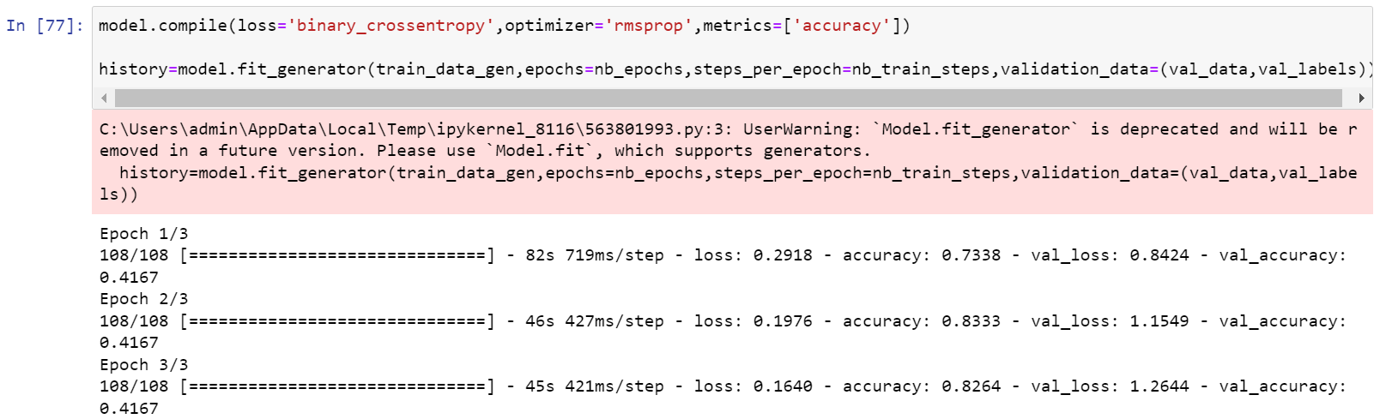
Model establishment in CNN:
A Relu activation is applied after every convolution to transform the output values between the range 0 to 1
Cross-entropy is used as loss function for 4 classes.
Rmsprop is used as optimizer function.
The cnn model is trained in 3 epochs with a batch size of 12 which resulted in 108 batches.
The resulted accuracy i.e 82.6 % is as follows:

Slide 23
Results and Evaluation:
Model used | Accuracy obtained
Decision Trees | 82.2%
Random Forest | 85.5%
Logistic Regression | 84.4%
Multi layer Perceptron | 91.7%
CNN | 82.6%

Slide 24
Thank You

